Slide 1



E-commerce Website Management Project
This project aims to design and implement an e-commerce website exclusively for clothing. Our e-commerce management system is all about – making life simpler for businesses and customers .From keeping track of products to making sure orders are delivered on time, our system has got it covered. It involves creating a database to support the functionality of the website, including tables .

Slide 2

Problem Statement
Designing and implementing a scalable Online Shopping Database Management System to streamline the operations of an e-commerce platform. The primary goal is to develop a comprehensive database system of online shopping, including product description, customer database, seller details, managing Wishlist of customer and keeping track of order status.

Slide 3
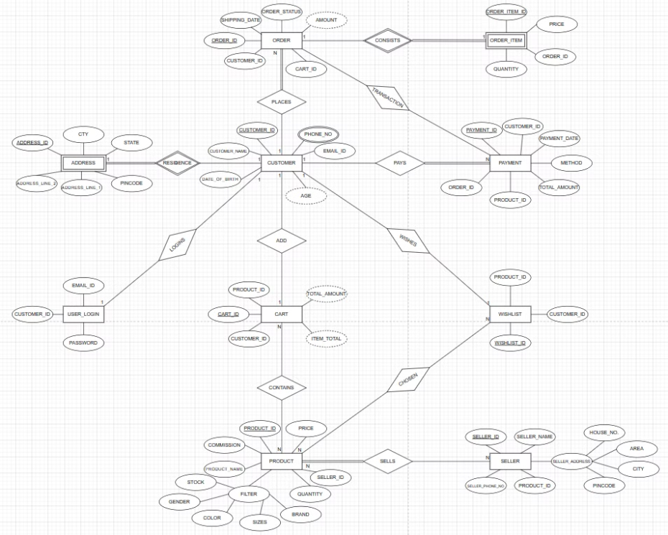
ER Diagram

Slide 4
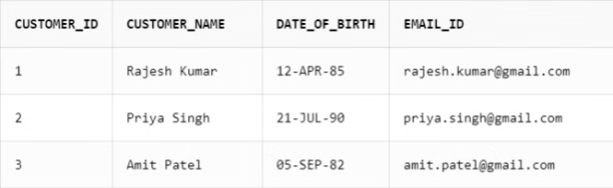
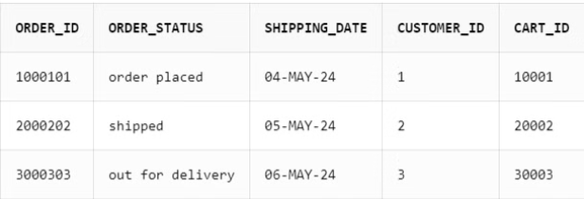
Database Tables
Customer Table
Orders Table
The website's Customer table manages user accounts with purchase activity. It stores personal information and order details for analysis and future interactions.
The Orders table contains details about the customer's purchases, including order IDs, product IDs, quantities, and timestamps. It also stores the status of each order, such as processing, shipped, or delivered.

Slide 5
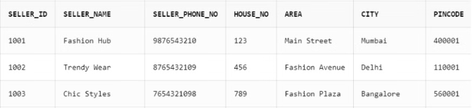
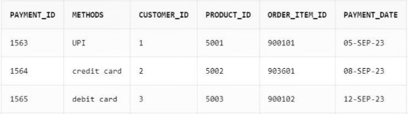
Database Tables
Seller Table
Payment Table
A Seller Table stores seller details and product listings, streamlining seller management and communication on the e-commerce platform.
The payment table stores details of payment methods used by customers for their orders, including UPI ,credit/debit card information and transaction records.

Slide 6
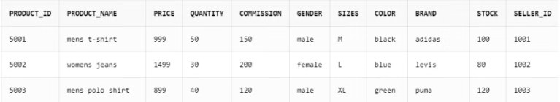
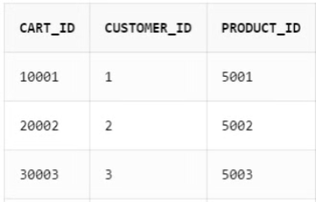
Database Tables
Product Table
Cart Table
The product table contains essential information about the products available on our e-commerce platform, including their names, descriptions, prices, and stock levels. It serves as the foundation for a seamless shopping experience.
Stores information about products a user has added to their cart. Typically includes user ID (if logged in), unique cart id, product ID. Enables the platform to remember a user's selections .

Slide 7
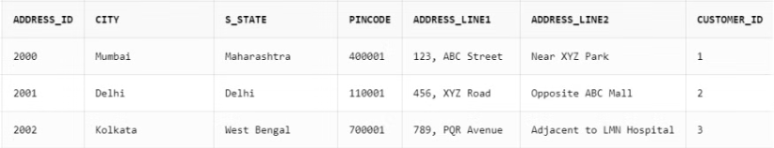
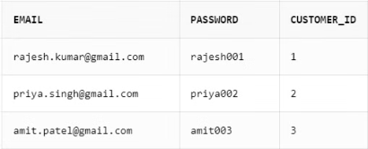
Database Tables
Address Table
User_login Table
Stores user shipping and billing addresses. Simplifies checkout by allowing users to choose pre-saved addresses for shipping and billing.
Stores user login credentials and account details.Enables secure user login, account management.

Slide 8
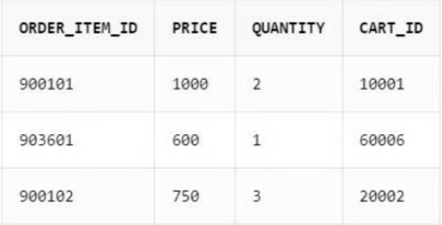
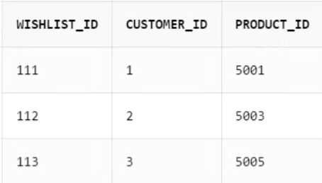
Database Tables
Order_item Table
Wishlist Table
Records specific items included in a finalized order. Provides a detailed breakdown of what was purchased in a specific order. This is crucial for order fulfillment, and potentially tracking customer preferences.
Stores information about products a user has saved for later consideration. Allows users to save products they're interested in but not ready to purchase. This enables them to revisit the items easily without searching again.

Slide 9
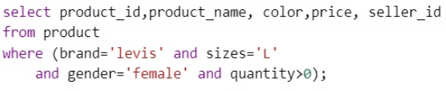
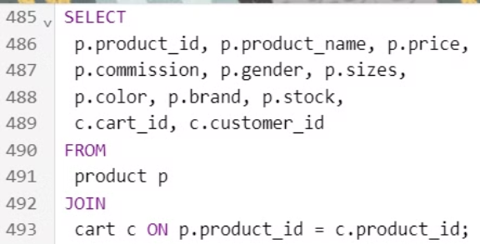
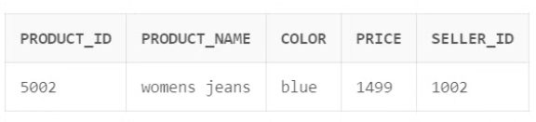
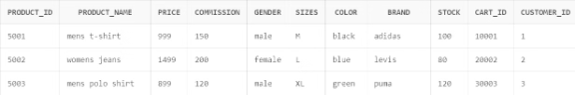
SQL Queries and Joins Demonstration
SQL Queries
Joins

Slide 10
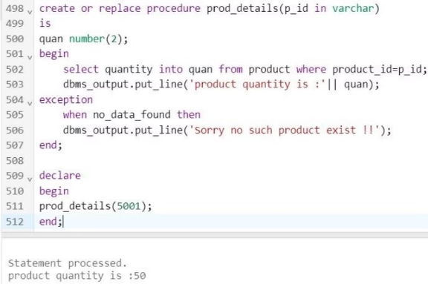
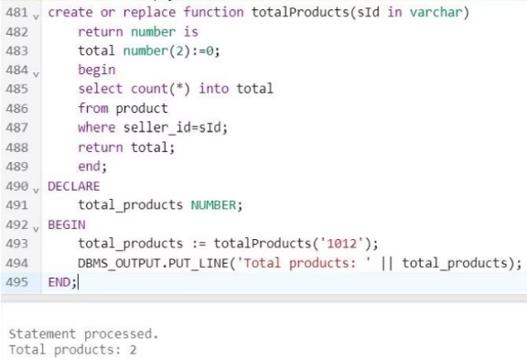
PL/SQL Queries and Demonstrations
Procedure
Functions
Procedure which returns the total quantity of product with the given ID
Function which returns total number of products which a particular seller sells.

Slide 11
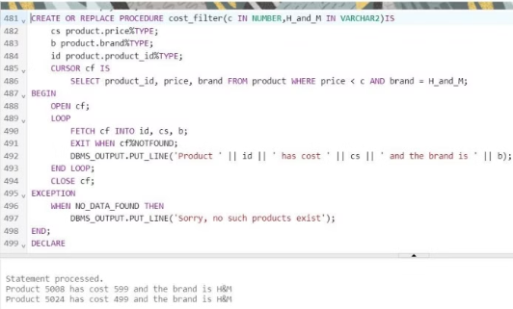
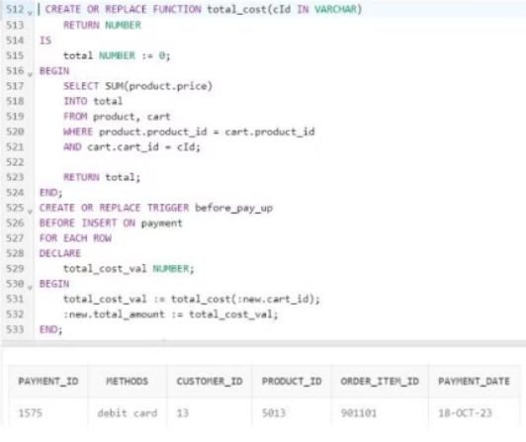
PL/SQL Queries and Demonstrations
Trigger
Cursor
Calculates the total cost of a shopping cart and a trigger to automatically set the total amount in a payment record based on the cart ID.
Procedure which returns the brand of product with the cost less than the given cost

Slide 12

Conclusion
The Online Shopping Management System empowers businesses to thrive online. It offers a one-stop shop for managing your store, streamlining operations, and delighting customers. Powerful databases keep track of products, suppliers, and customers, ensuring smooth product handling, order fulfillment, and communication. Built with security, scalability, and integrations in mind, this system adapts to the ever-changing digital marketplace, driving your e-commerce success.

Slide 13
Submitted by :
KASHIKA CHOPRA 102203492
KANIKA KUKKAR 102203559
RIDDHI SEKHRI 102203598
SMRITI SINGH 102203604

